Slide 1
Circuits, Digital Representation & Data Acquisition
C. Marone & C. Wood
Techniques of Geophysical
Experimentation
10 Feb. 2021

Slide 2
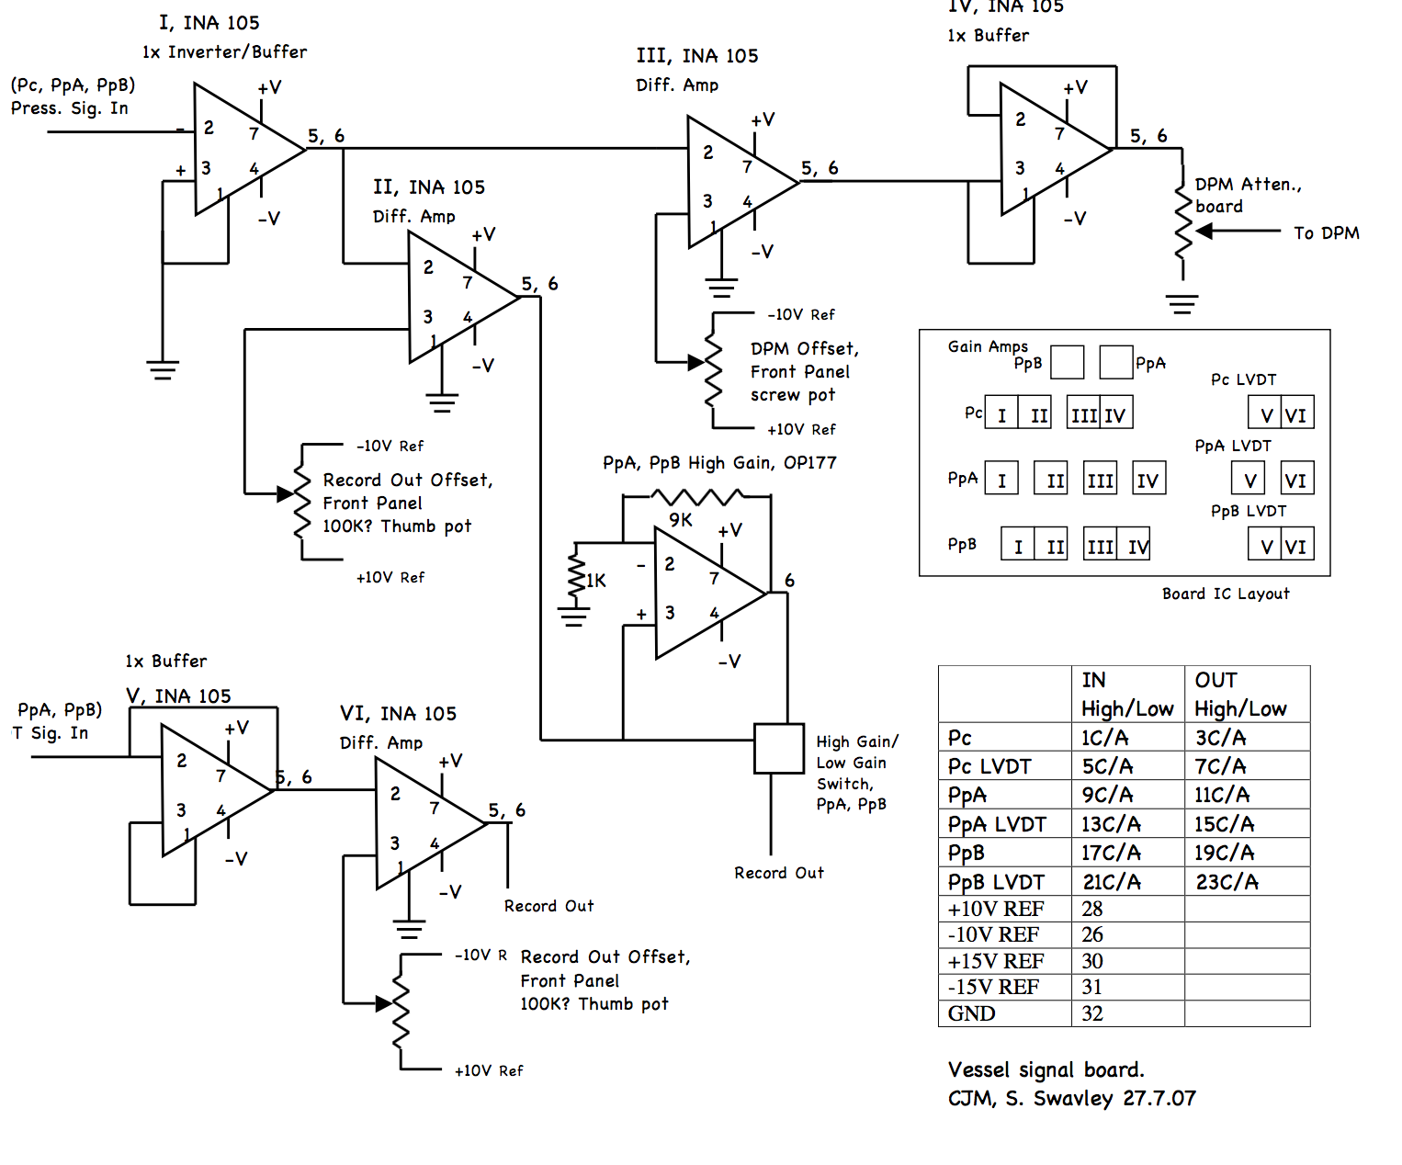
Transducers, servo control and offsets

Slide 3
www.ti.com/product/INA105
www.ti.com/document-viewer/INA129/datasheet

Slide 4
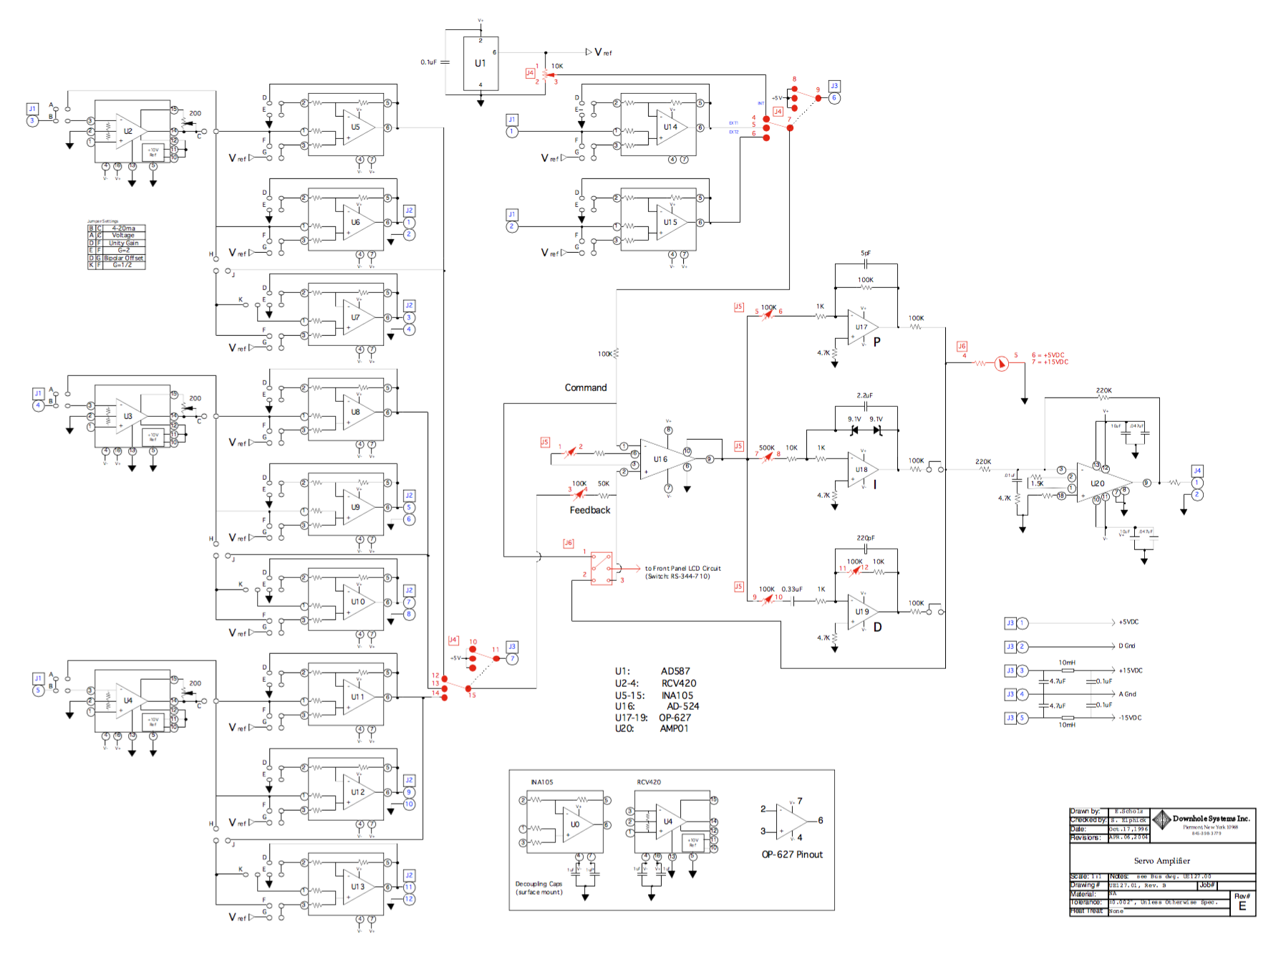

Slide 5
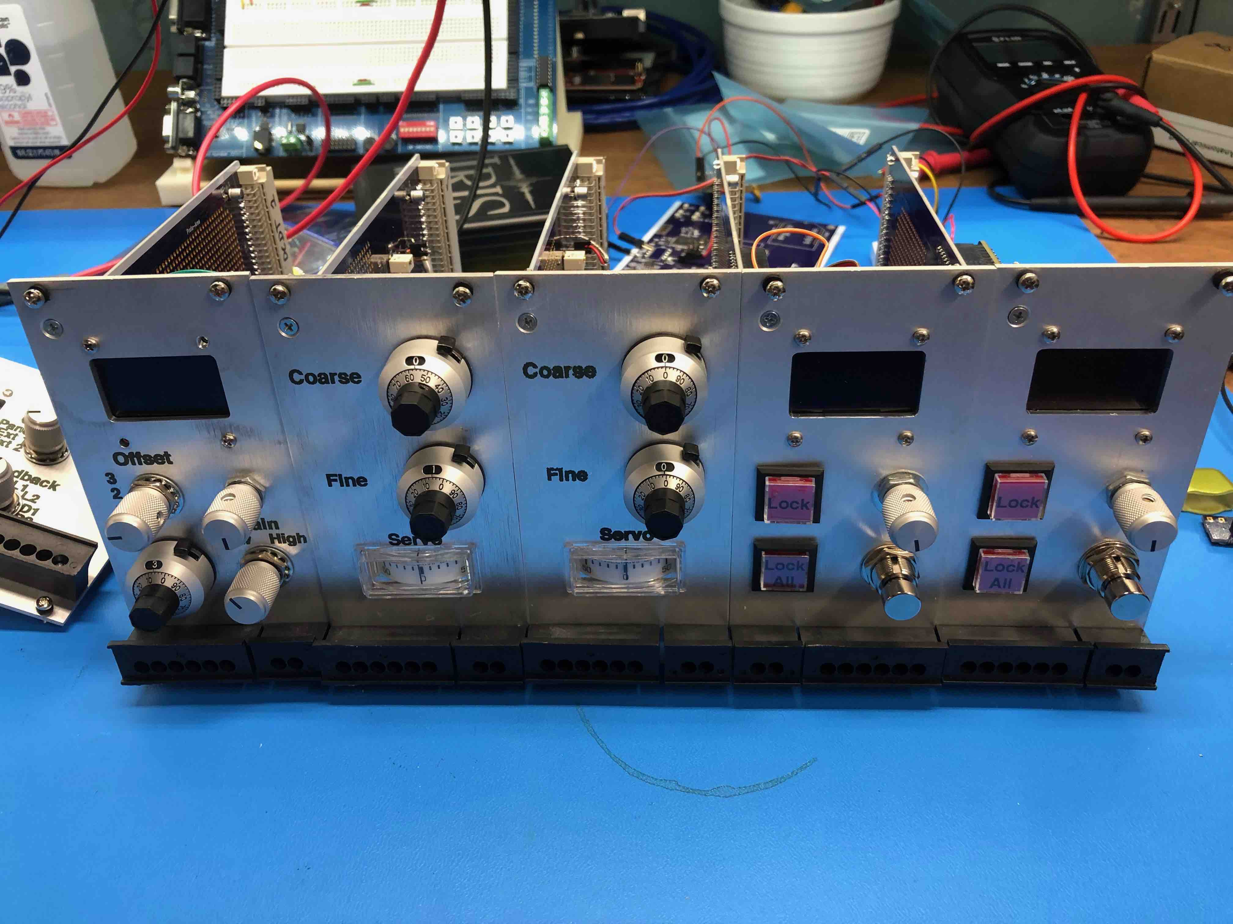
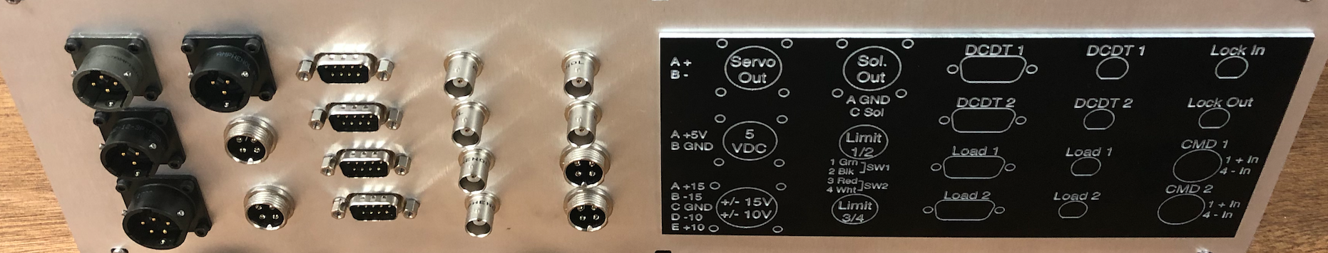

Slide 6
We measure the real world with transducers

Slide 7
The process of collecting and storing data is called data acquisition or DAQ
Physical
System
Transducer
Sensor
Signal
Conditioning
ADC
Computer
Notes:
Theory is when you know everything, but nothing works. Practice is when everything works, but no one knows why. In our lab, theory and practice are combined: nothing works and no one knows why.

Slide 8
We often need to condition the signal to make it useable
Image: electronics-tutorials.ws
Notes:
Theory is when you know everything, but nothing works. Practice is when everything works, but no one knows why. In our lab, theory and practice are combined: nothing works and no one knows why.

Slide 9
The signal is then converted to a digital representation with an analog to digital converter
ADC
Images: sparkfun.com
Notes:
Theory is when you know everything, but nothing works. Practice is when everything works, but no one knows why. In our lab, theory and practice are combined: nothing works and no one knows why.

Slide 10
ADC resolution is specified by the number of bits used
Image: ni.com
Notes:
Theory is when you know everything, but nothing works. Practice is when everything works, but no one knows why. In our lab, theory and practice are combined: nothing works and no one knows why.

Slide 11
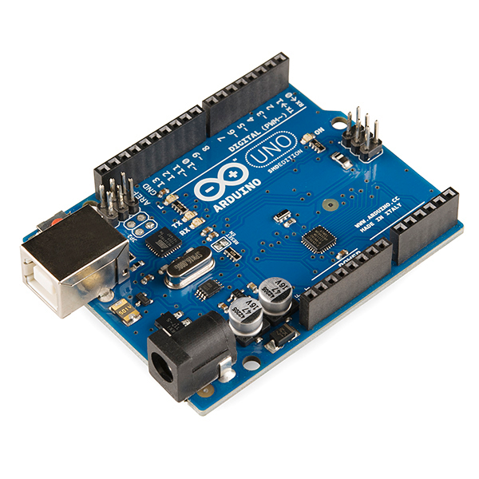
Let’s calculate the resolution of our Arduino ADC
Image: wikipedia.com
Notes:
Theory is when you know everything, but nothing works. Practice is when everything works, but no one knows why. In our lab, theory and practice are combined: nothing works and no one knows why.

Slide 12
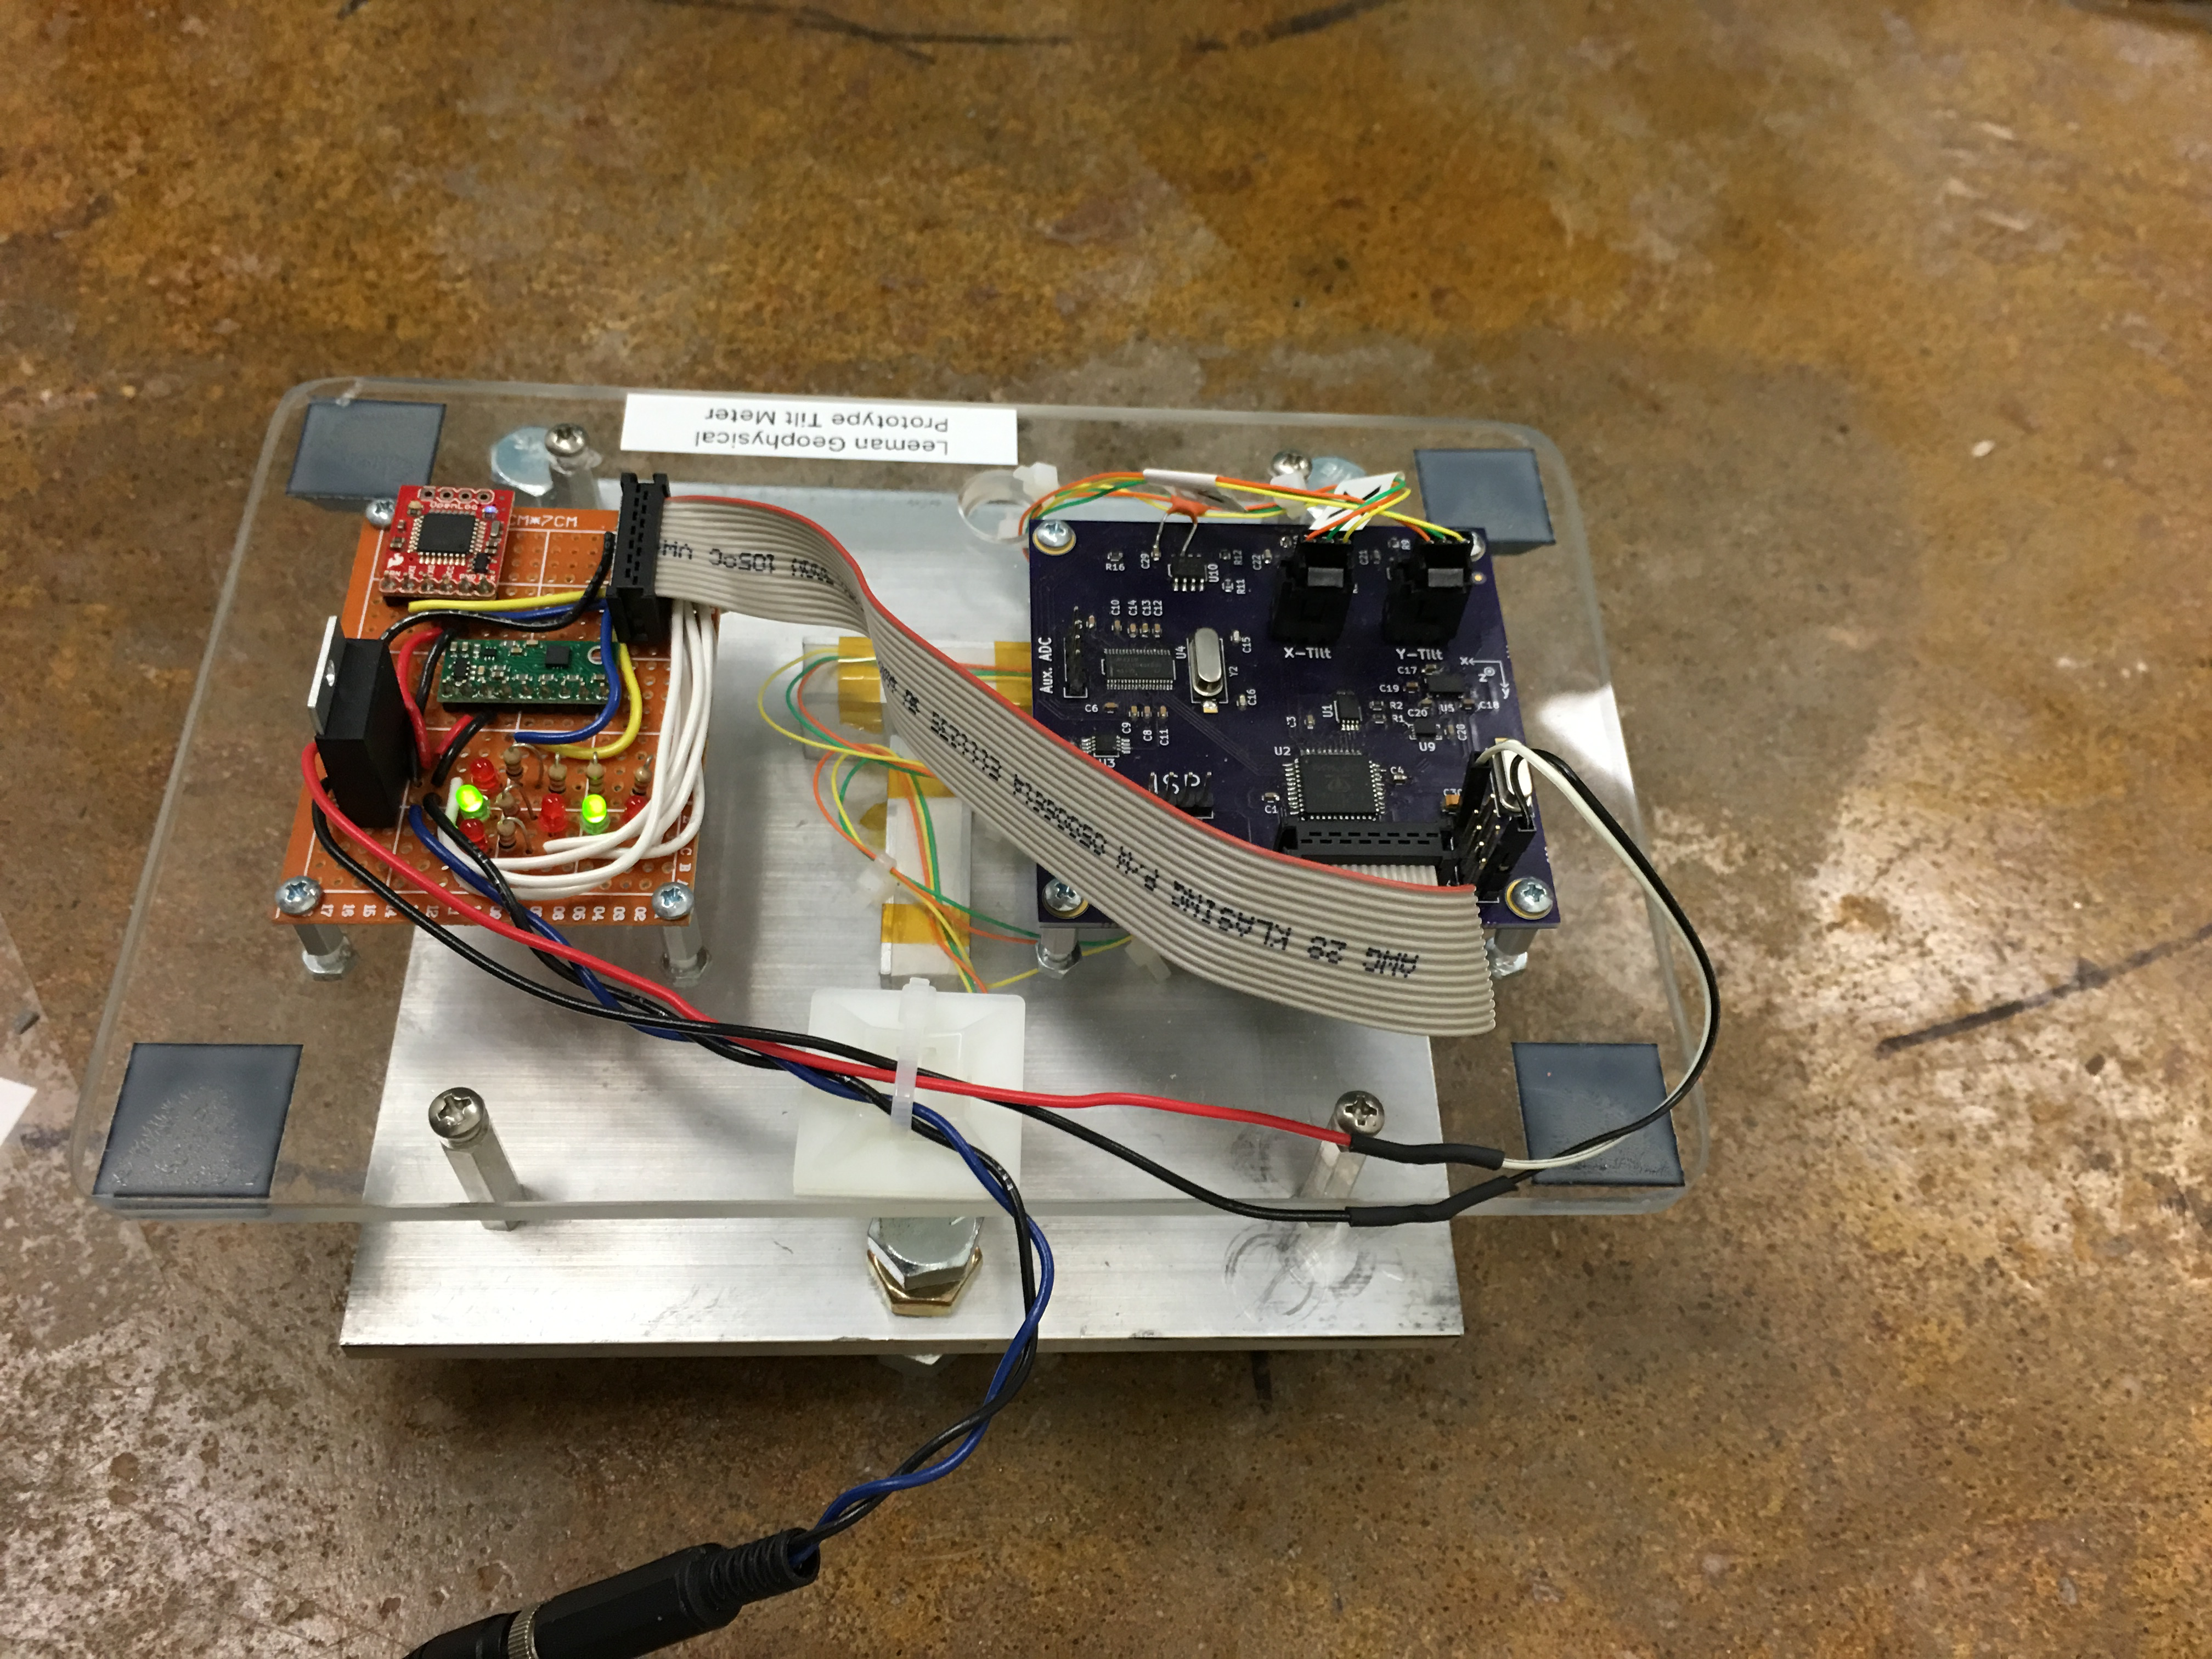
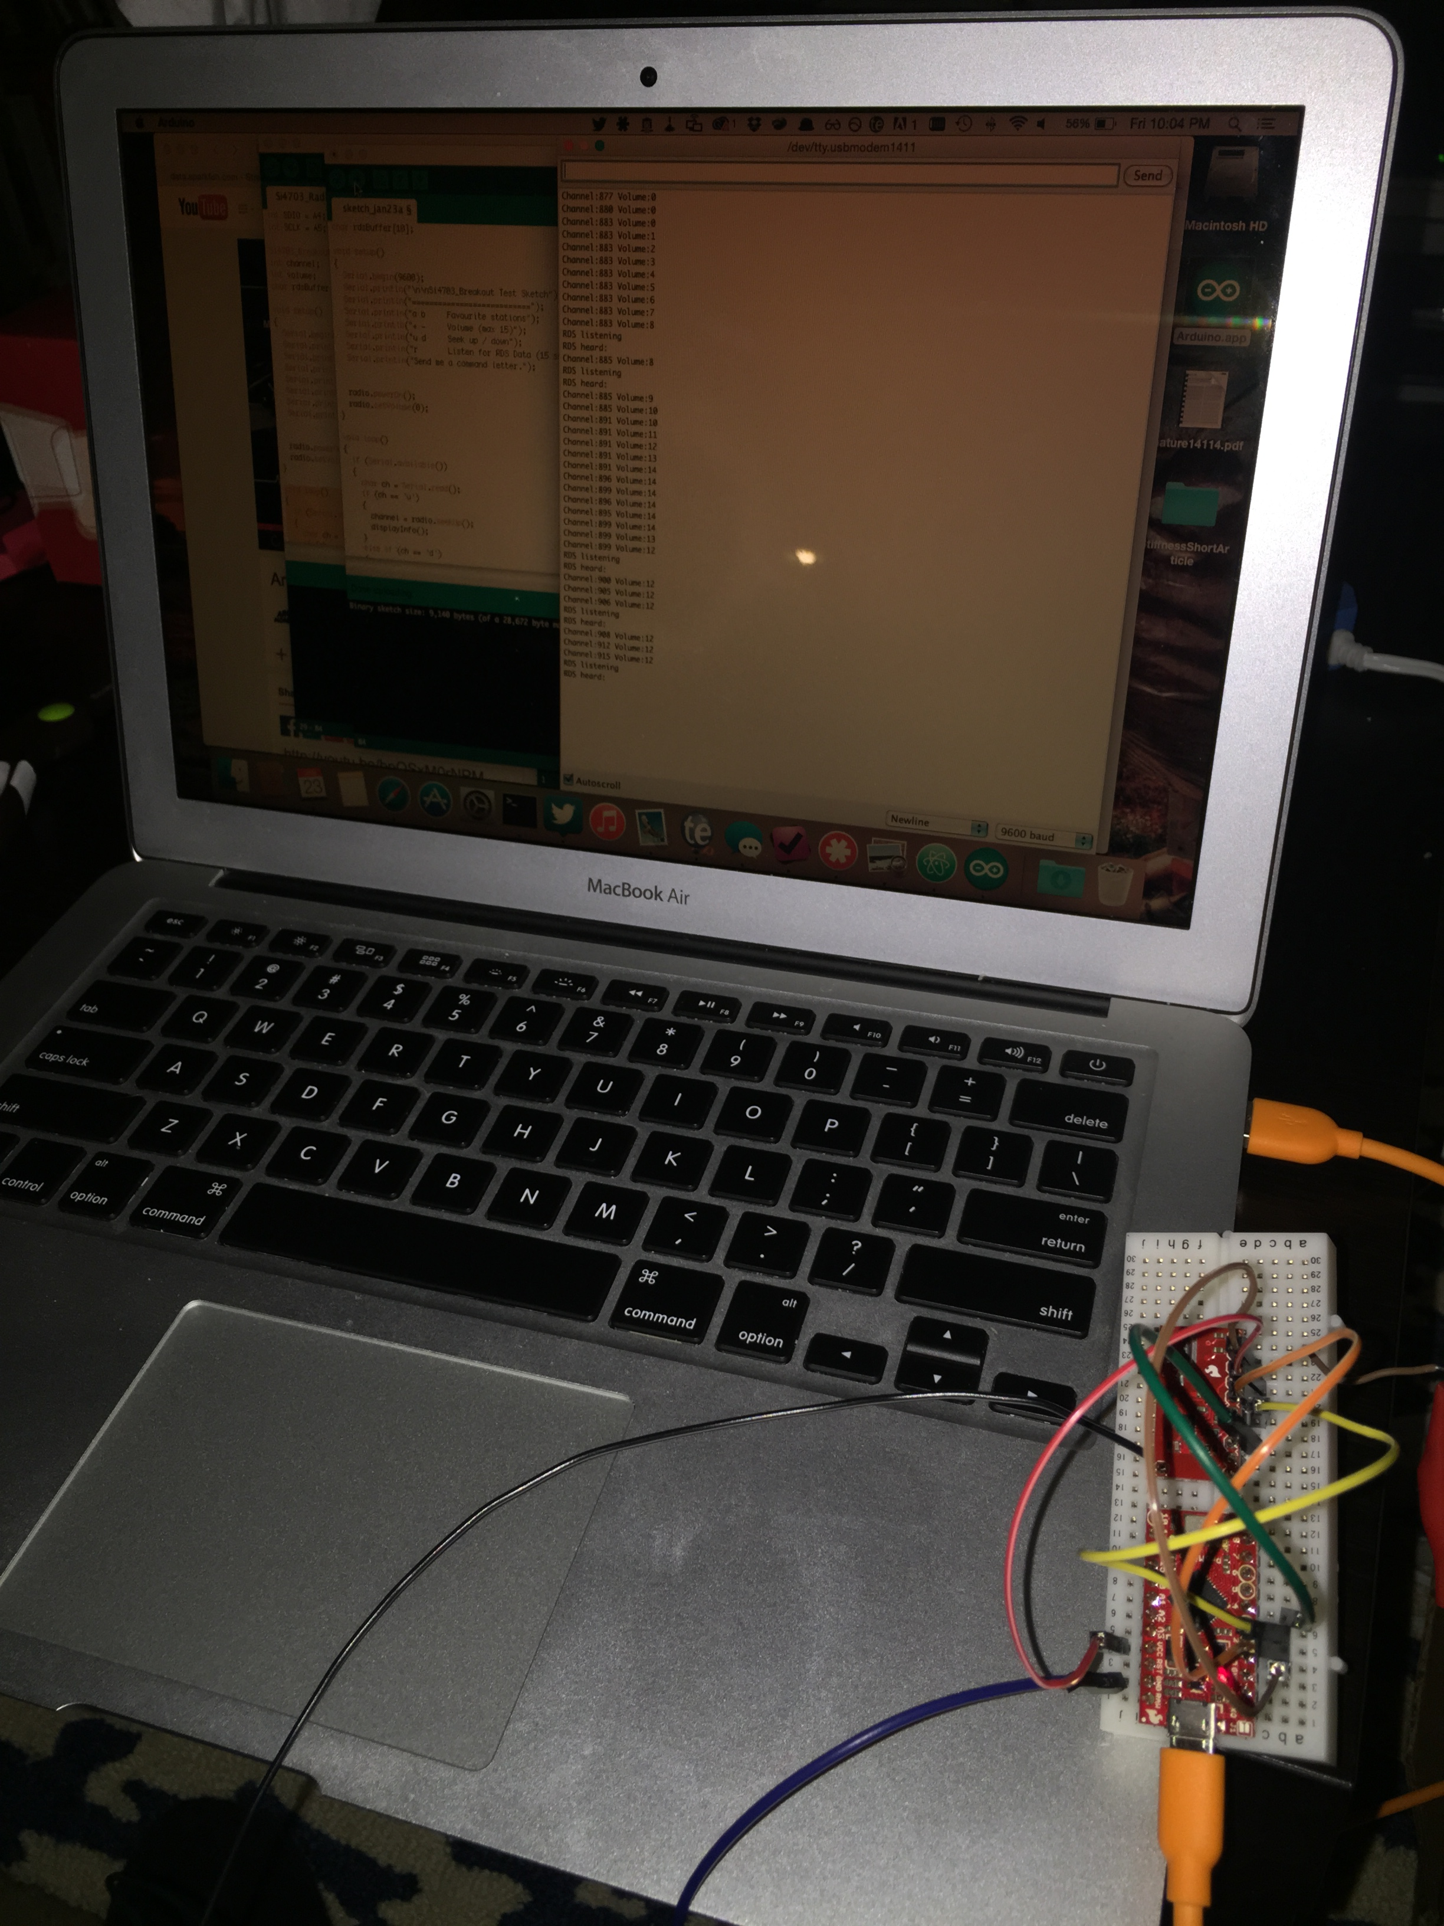
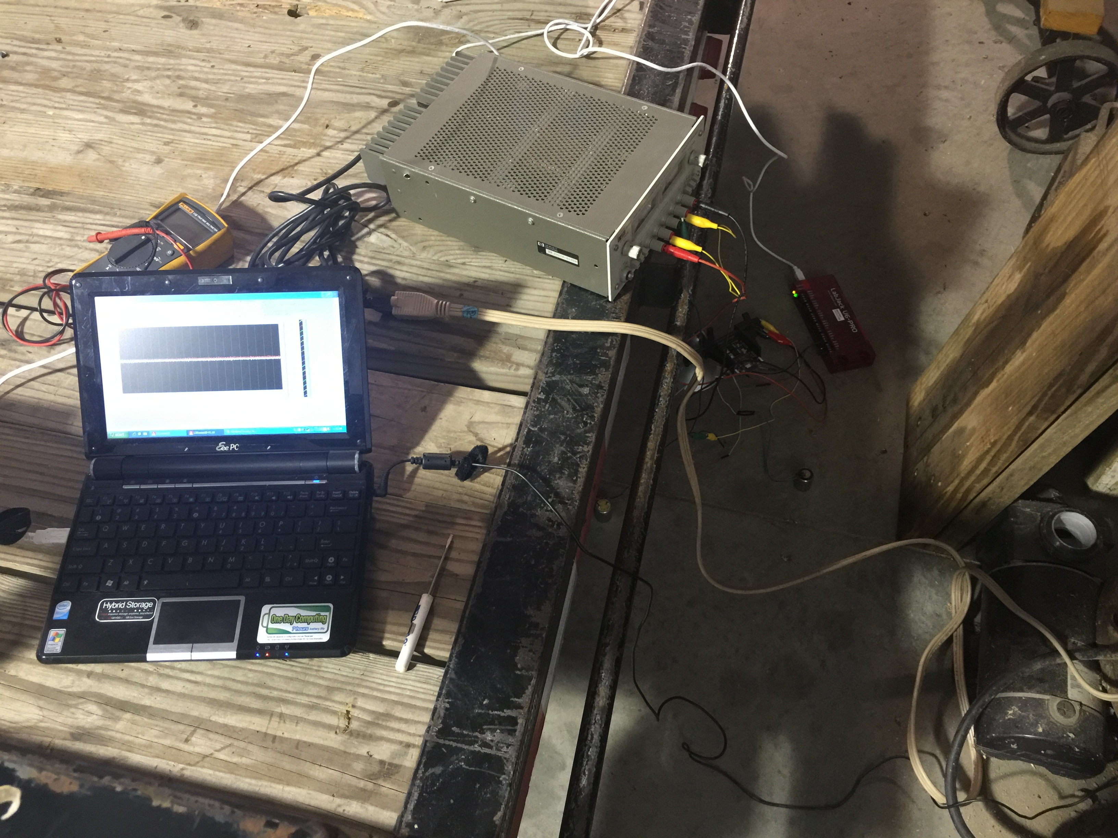
Finally data are stored or processed by a computer or micro controller
Images: J.R. Leeman
Notes:
Theory is when you know everything, but nothing works. Practice is when everything works, but no one knows why. In our lab, theory and practice are combined: nothing works and no one knows why.

Slide 13
We apply calibrations to convert the digital back to the physical units we actually wanted
2.45 Volts
0.01483 Volts/lbs
67.4 lbs/Volt
165.2 lbs
Notes:
We’re going to take a quick look at the structure of an ice stream. For the glaciologists in the room, this isn’t anything new, but it’s always nice to quickly review. Here we have a very generalized cartoon that we’re going to zoom into and look at the base, the surface, and the shelf. We’ll start up top with the stresses and then go down into the base and till.

Slide 14
Let’s learn how to translate binary numbers into base 10 representations
A7 | A6 | A5 | A4 | A3 | A2 | A1 | A0
128 | 64 | 32 | 16 | 8 | 4 | 2 | 1
Notes:
Theory is when you know everything, but nothing works. Practice is when everything works, but no one knows why. In our lab, theory and practice are combined: nothing works and no one knows why.

Slide 15
Let’s learn how to translate binary numbers into base 10 representations
A7 | A6 | A5 | A4 | A3 | A2 | A1 | A0
128 | 64 | 32 | 16 | 8 | 4 | 2 | 1
0 | 1 | 0 | 1 | 1 | 0 | 1 | 1
Notes:
Theory is when you know everything, but nothing works. Practice is when everything works, but no one knows why. In our lab, theory and practice are combined: nothing works and no one knows why.

Slide 16
Let’s learn how to translate binary numbers into base 10 representations
A7 | A6 | A5 | A4 | A3 | A2 | A1 | A0
128 | 64 | 32 | 16 | 8 | 4 | 2 | 1
0 | 1 | 0 | 1 | 1 | 0 | 1 | 1
0 | 64 | 0 | 16 | 8 | 0 | 2 | 1
Notes:
Theory is when you know everything, but nothing works. Practice is when everything works, but no one knows why. In our lab, theory and practice are combined: nothing works and no one knows why.

Slide 17
Let’s learn how to translate binary numbers into base 10 representations
A7 | A6 | A5 | A4 | A3 | A2 | A1 | A0
128 | 64 | 32 | 16 | 8 | 4 | 2 | 1
0 | 1 | 0 | 1 | 1 | 0 | 1 | 1
0 | 64 | 0 | 16 | 8 | 0 | 2 | 1
 |  |  |  |  |  |  | 91
Notes:
Theory is when you know everything, but nothing works. Practice is when everything works, but no one knows why. In our lab, theory and practice are combined: nothing works and no one knows why.

Slide 18
The most significant bit can be first or last, we just have to agree and know what was done
Image: users.cis.fiu.edu
Notes:
Theory is when you know everything, but nothing works. Practice is when everything works, but no one knows why. In our lab, theory and practice are combined: nothing works and no one knows why.

Slide 19
Endianness gets its name from Swift’s Gulliver’s Travels
Image: flickeringtubelight.com
Notes:
Theory is when you know everything, but nothing works. Practice is when everything works, but no one knows why. In our lab, theory and practice are combined: nothing works and no one knows why.

Slide 20
We’ve explored base 10 and base 2, but what if we want more than 0-9? Base 16!
0, 1, 2, 3, 4, 5, 6, 7, 8, 9, A, B, C, D, E, F
Image: sparkfun.com
Notes:
Theory is when you know everything, but nothing works. Practice is when everything works, but no one knows why. In our lab, theory and practice are combined: nothing works and no one knows why.

Slide 21
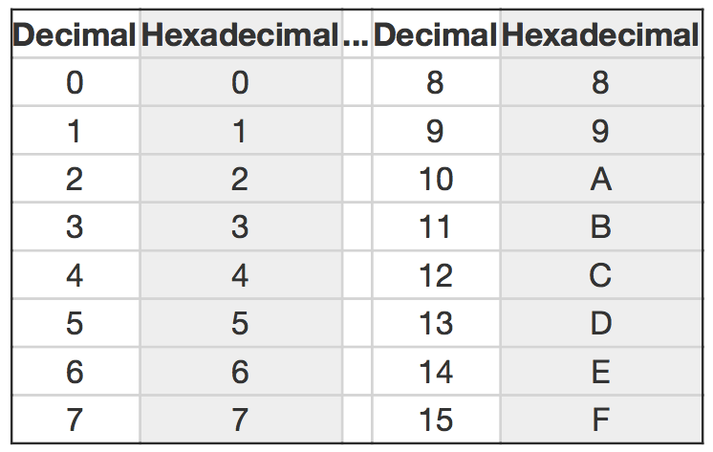
Counting is a bit strange since we’re used to base 10
Image: sparkfun.com
Notes:
Theory is when you know everything, but nothing works. Practice is when everything works, but no one knows why. In our lab, theory and practice are combined: nothing works and no one knows why.

Slide 22
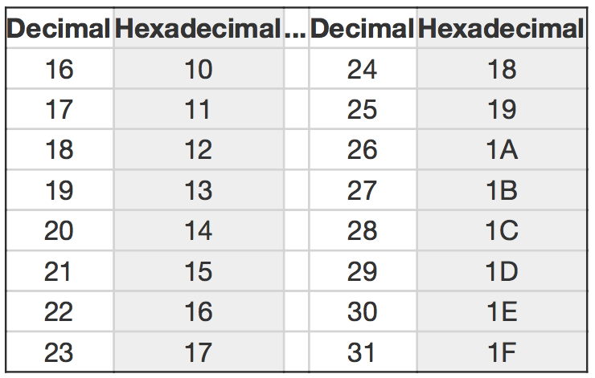
Counting is a bit strange since we’re used to base 10
Image: sparkfun.com
Notes:
Theory is when you know everything, but nothing works. Practice is when everything works, but no one knows why. In our lab, theory and practice are combined: nothing works and no one knows why.

Slide 23
Let’s convert the decimal number 48879 to hex
48879/16 = 3054 R 15
> F
3054/16 = 190 R 14
> EF
190/16 = 11 R 14
> EEF
11/16 = 0 R 11
> BEEF
Notes:
Theory is when you know everything, but nothing works. Practice is when everything works, but no one knows why. In our lab, theory and practice are combined: nothing works and no one knows why.

Slide 24
Converting to binary is a powers of 16 problem
A7 | A6 | A5 | A4 | A3 | A2 | A1 | A0
16⁷ | 16⁶ | 16⁵ | 16⁴ | 16³ | 16² | 16¹ | 16⁰
268435456 | 16777216 | 1048576 | 65536 | 4096 | 256 | 16 | 1
Notes:
Theory is when you know everything, but nothing works. Practice is when everything works, but no one knows why. In our lab, theory and practice are combined: nothing works and no one knows why.

Slide 25
Converting from binary is done by grouping into bunches of 4
Binary: 1011111011101111
Binary: 1011 | 1110 | 1110 | 1111
Decimal: 11 | 14 | 14 | 15
HEX: B | E | E | F
Notes:
Theory is when you know everything, but nothing works. Practice is when everything works, but no one knows why. In our lab, theory and practice are combined: nothing works and no one knows why.

Slide 26
You’ll see all of these formats written in a variety of ways
Hex
0xBEEF
#FF7454
%20
\x1B
&#BD
0hBEEF
BEEF16
BEEFhex
Binary
0b01110100
%01110100
%0111_0100
Notes:
Theory is when you know everything, but nothing works. Practice is when everything works, but no one knows why. In our lab, theory and practice are combined: nothing works and no one knows why.

Slide 27
Two’s complement lets us represent negative numbers
8-bit
uint8_t | 0 to 255
int8_t | -128 to 127
Notes:
Theory is when you know everything, but nothing works. Practice is when everything works, but no one knows why. In our lab, theory and practice are combined: nothing works and no one knows why.

Slide 28
Converting to two’s compliment is “simple”
Write out the number in binary
Invert all of the digits
Add one to the result
Notes:
Theory is when you know everything, but nothing works. Practice is when everything works, but no one knows why. In our lab, theory and practice are combined: nothing works and no one knows why.

Slide 29
Write the number -42
Write out the number in binary
Invert all of the digits
Add one to the result
42 = 2 + 8 + 32
0010_1010
Notes:
Theory is when you know everything, but nothing works. Practice is when everything works, but no one knows why. In our lab, theory and practice are combined: nothing works and no one knows why.

Slide 30
Write the number -42
Write out the number in binary
Invert all of the digits
Add one to the result
0010_1010
1101_0101
Notes:
Theory is when you know everything, but nothing works. Practice is when everything works, but no one knows why. In our lab, theory and practice are combined: nothing works and no one knows why.

Slide 31
Write the number -42
Write out the number in binary
Invert all of the digits
Add one to the result
1101_0101
1101_0110
Notes:
Theory is when you know everything, but nothing works. Practice is when everything works, but no one knows why. In our lab, theory and practice are combined: nothing works and no one knows why.

Slide 32
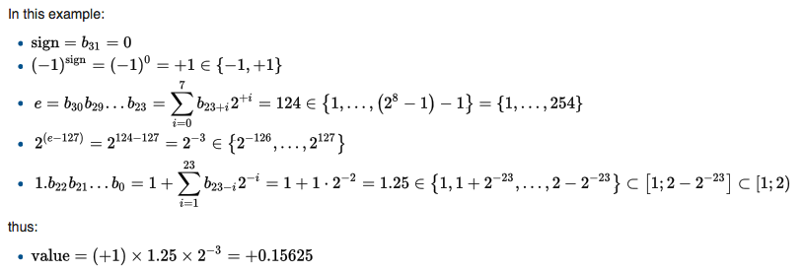
Floating point is expensive, but useful
Single-Precision
sign * 2^{exponent} * mantissa
Image: wikipedia.com
Notes:
Theory is when you know everything, but nothing works. Practice is when everything works, but no one knows why. In our lab, theory and practice are combined: nothing works and no one knows why.

Slide 33
Not all representations are exact and can accumulate error
Double-Precision
Decimal Number: 0.1
Single Precision: 0x3DCCCCCD
Cast to Double: 0.10000000149011612
1e6 * 0.1 (cast to double) = 100000.00149011612
Image: wikipedia.com
Notes:
Theory is when you know everything, but nothing works. Practice is when everything works, but no one knows why. In our lab, theory and practice are combined: nothing works and no one knows why.

Slide 34
Assignment: Digital Representation
DUE: 9/27/16
Notes:
Theory is when you know everything, but nothing works. Practice is when everything works, but no one knows why. In our lab, theory and practice are combined: nothing works and no one knows why.

Slide 35
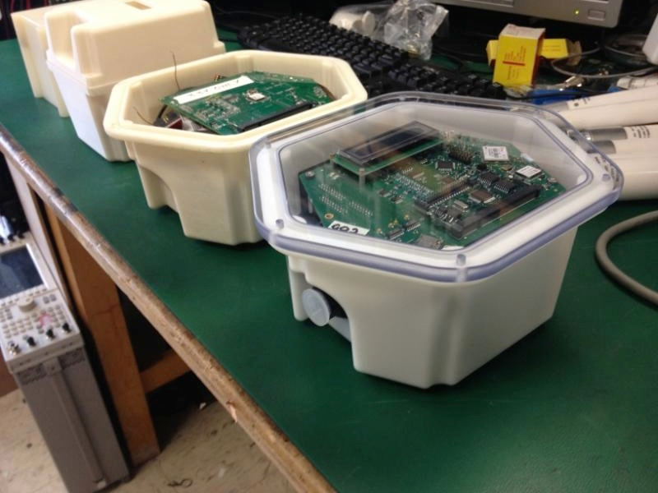
There are continuous and triggered DAQ systems
Image: S. Anandakrishnan
Notes:
Theory is when you know everything, but nothing works. Practice is when everything works, but no one knows why. In our lab, theory and practice are combined: nothing works and no one knows why.

Slide 36
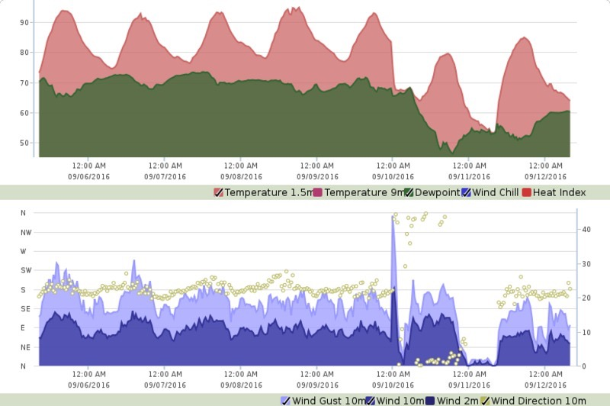
A continuous system records things that are constantly changing with time in an unknown way
Image: mesonet.org
Notes:
Theory is when you know everything, but nothing works. Practice is when everything works, but no one knows why. In our lab, theory and practice are combined: nothing works and no one knows why.

Slide 37
Make sure that you are sampling at an adequate frequency
Image: wikipedia.com
Notes:
Theory is when you know everything, but nothing works. Practice is when everything works, but no one knows why. In our lab, theory and practice are combined: nothing works and no one knows why.

Slide 38
Make sure that you are sampling at an adequate resolution
Image: wikipedia.com
Notes:
Theory is when you know everything, but nothing works. Practice is when everything works, but no one knows why. In our lab, theory and practice are combined: nothing works and no one knows why.

Slide 39
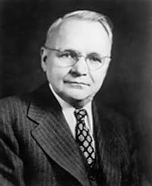
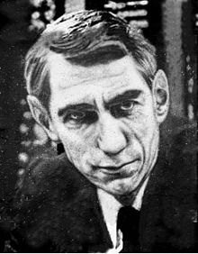
Your sampling should be guided by Nyquist-Shannon theory
Harry Nyquist (1889–1976)
Claude Shannon (1916-2001)
Image: wikipedia.com
Notes:
Theory is when you know everything, but nothing works. Practice is when everything works, but no one knows why. In our lab, theory and practice are combined: nothing works and no one knows why.

Slide 40
Make sure signals have a clean path through the system
Images: wikipedia.com
Notes:
Theory is when you know everything, but nothing works. Practice is when everything works, but no one knows why. In our lab, theory and practice are combined: nothing works and no one knows why.

Slide 41
Watch out for loading of the transducer/system by the measurement system
Transducer
Sensor
ADC
Transducer
Sensor
Buffer
ADC
Notes:
Theory is when you know everything, but nothing works. Practice is when everything works, but no one knows why. In our lab, theory and practice are combined: nothing works and no one knows why.

Slide 42
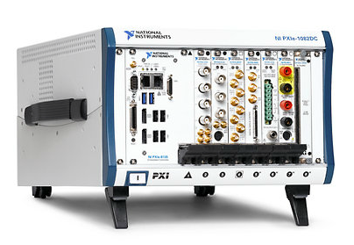
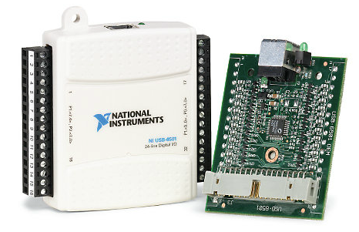
National Instruments produces some of the leading DAQ hardware around
Images: ni.com
Notes:
Theory is when you know everything, but nothing works. Practice is when everything works, but no one knows why. In our lab, theory and practice are combined: nothing works and no one knows why.

Slide 43
It is programmed through the graphical LabView language
Image: labviewrobotics.wordpress.com
Notes:
Theory is when you know everything, but nothing works. Practice is when everything works, but no one knows why. In our lab, theory and practice are combined: nothing works and no one knows why.

Slide 44
You’ll need training and/or professional help
Image: ni.com
Notes:
Theory is when you know everything, but nothing works. Practice is when everything works, but no one knows why. In our lab, theory and practice are combined: nothing works and no one knows why.

Slide 45
LabJack is another handy device that has many interfaces and DAQ tools
Image: labjack.com
Notes:
Theory is when you know everything, but nothing works. Practice is when everything works, but no one knows why. In our lab, theory and practice are combined: nothing works and no one knows why.

Slide 46
There are also field/equipment specific DAQ devices
Image: gdsinstruments.com
Notes:
Theory is when you know everything, but nothing works. Practice is when everything works, but no one knows why. In our lab, theory and practice are combined: nothing works and no one knows why.

Slide 47
Activity: Data Acquisition

